Slide 1

SelectStar Dental Clinic
Team Members:
Isha Madan – 001393098
Prasham Shah – 001057833
Rajavi Mehta – 001057845
Saurabh Satra – 001059412

Slide 2
Overview
Developed an appointment booking system -
‘SelectStar dental clinic’
System Functionalities -
1)Add a patient
2)Edit patient’s information
3)Select dentist and book an appointment
4)View Appointment History
5) Avoiding Conflicts for Appointment Booking

Slide 3
Key Subject Areas
Patient
Treatment
Location
Dentist

Slide 4
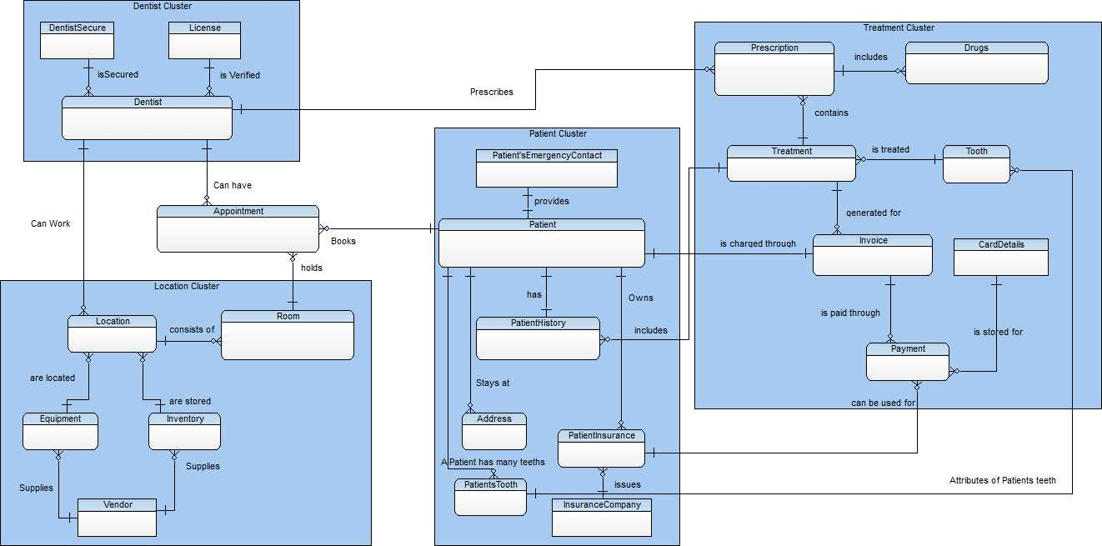
Entity Clusters

Slide 5
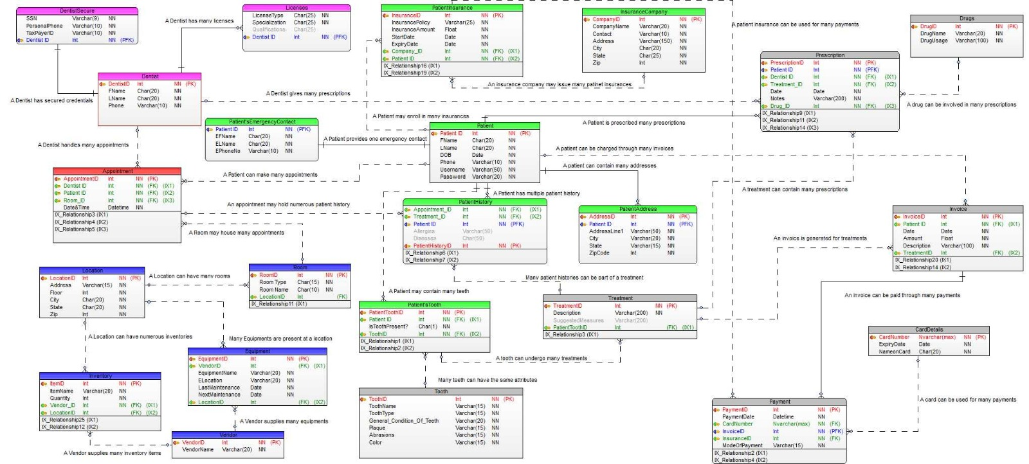
Model Diagram

Slide 6
Technologies used:
Frontend: HTML, CSS, JAVASCRIPT
Backend: PHP using PHPMyAdmin, MySQL
Server: WAMP Server
Toad Data Modeller

Slide 7
Sessions Created
Patient login
Admin login

Slide 8
Features
Create New Patient and patient emergency details
Read Patient’s appointments
Update Patient details and patient emergency details
Delete patient
Manage Patient Information by implementing search patient
Encryption of SSN

Slide 9
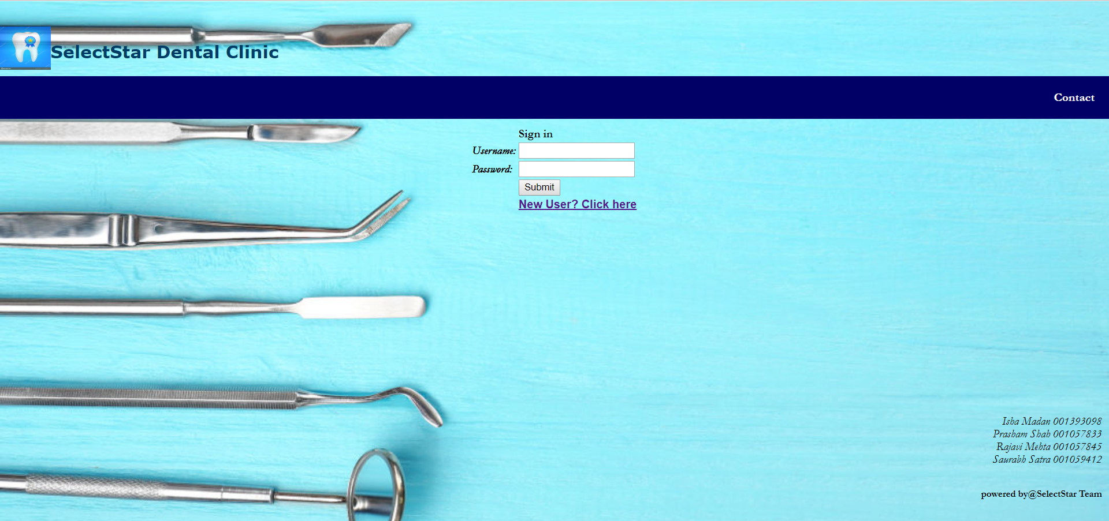
Homepage

Slide 10
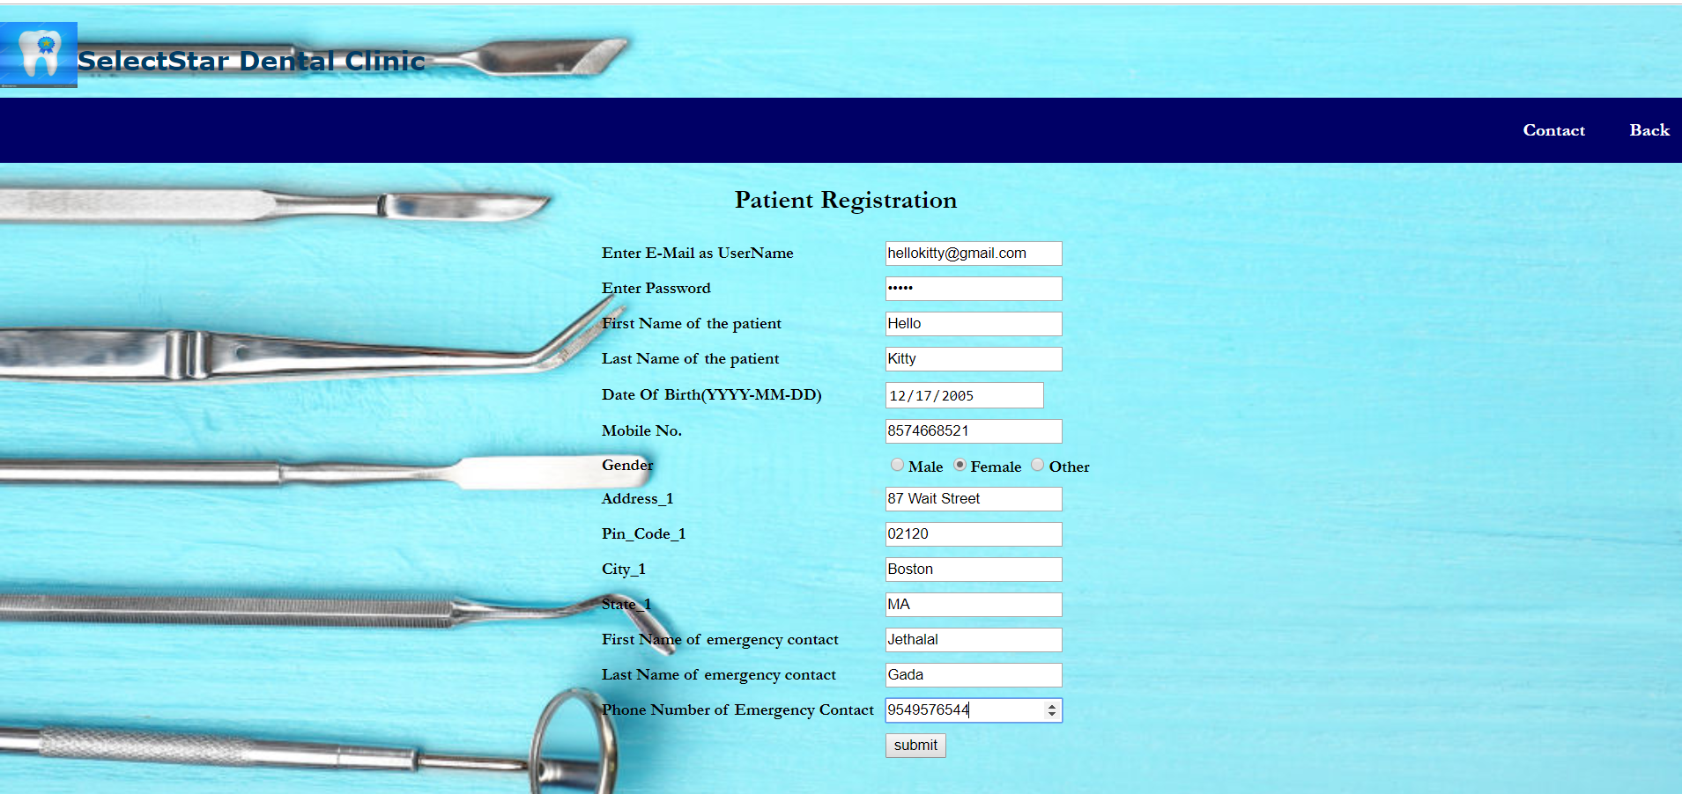
Add New Patient

Slide 11
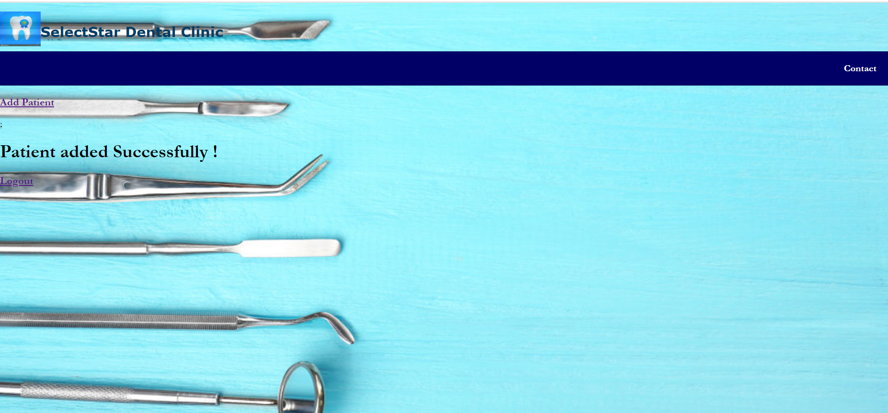
Patient creation success page

Slide 12
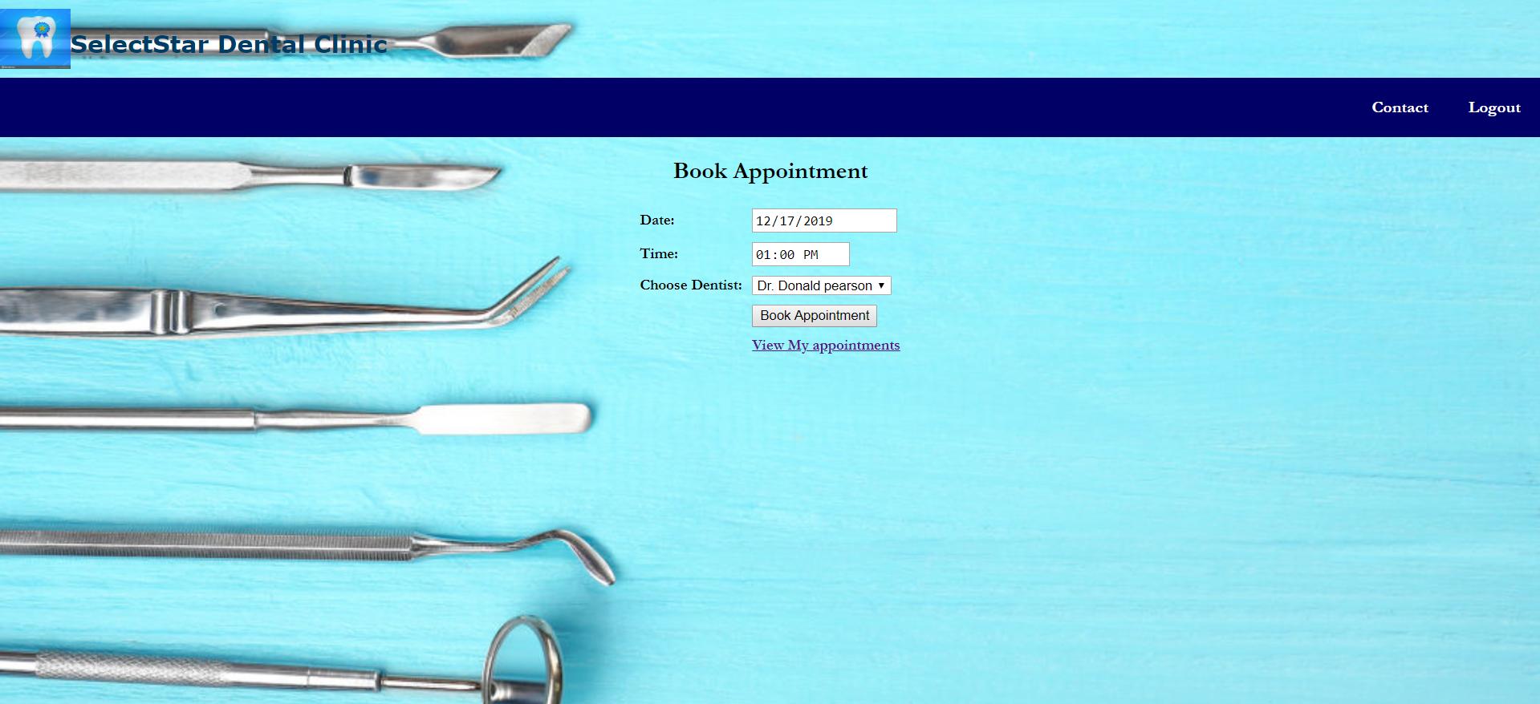
Book an Appointment

Slide 13
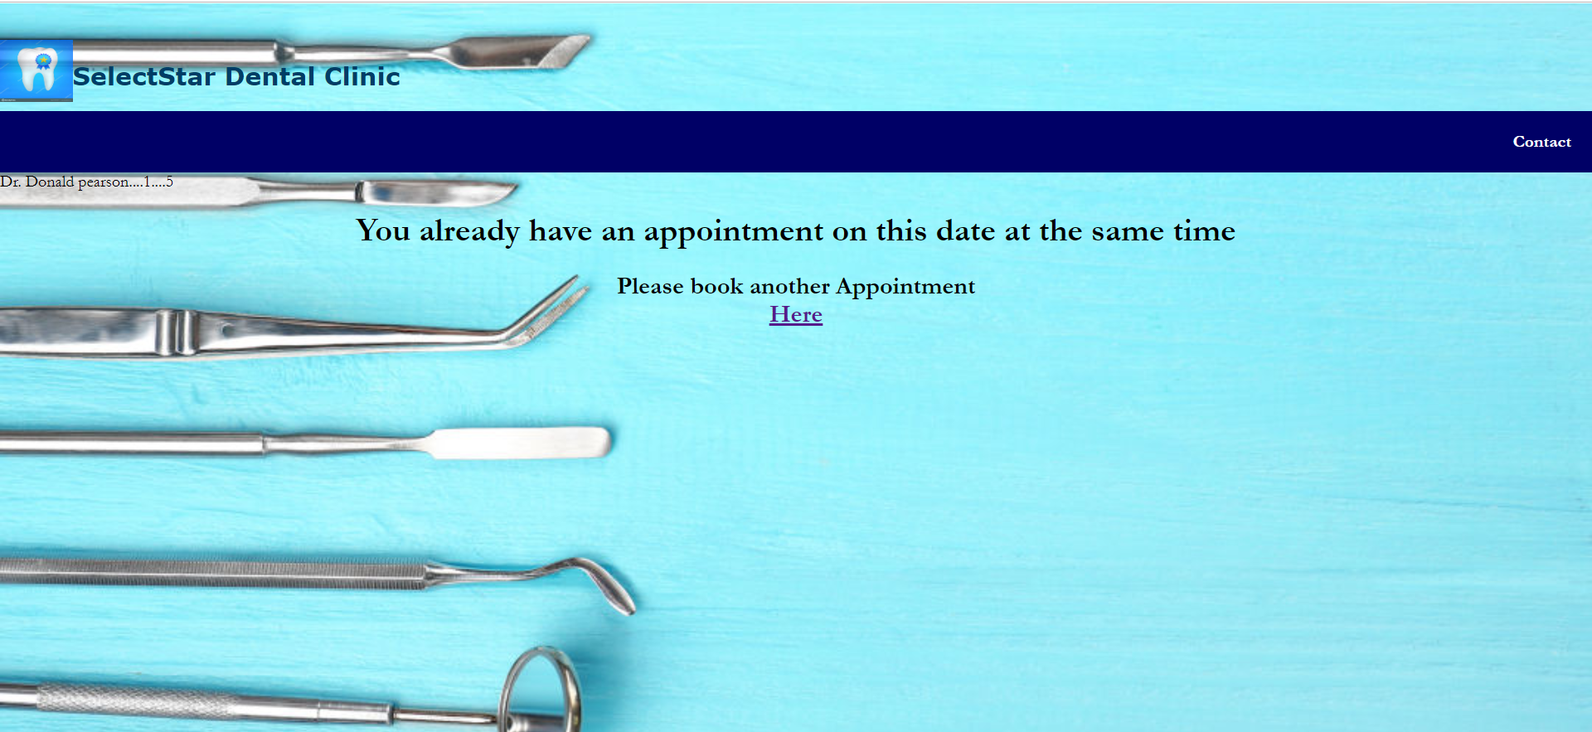
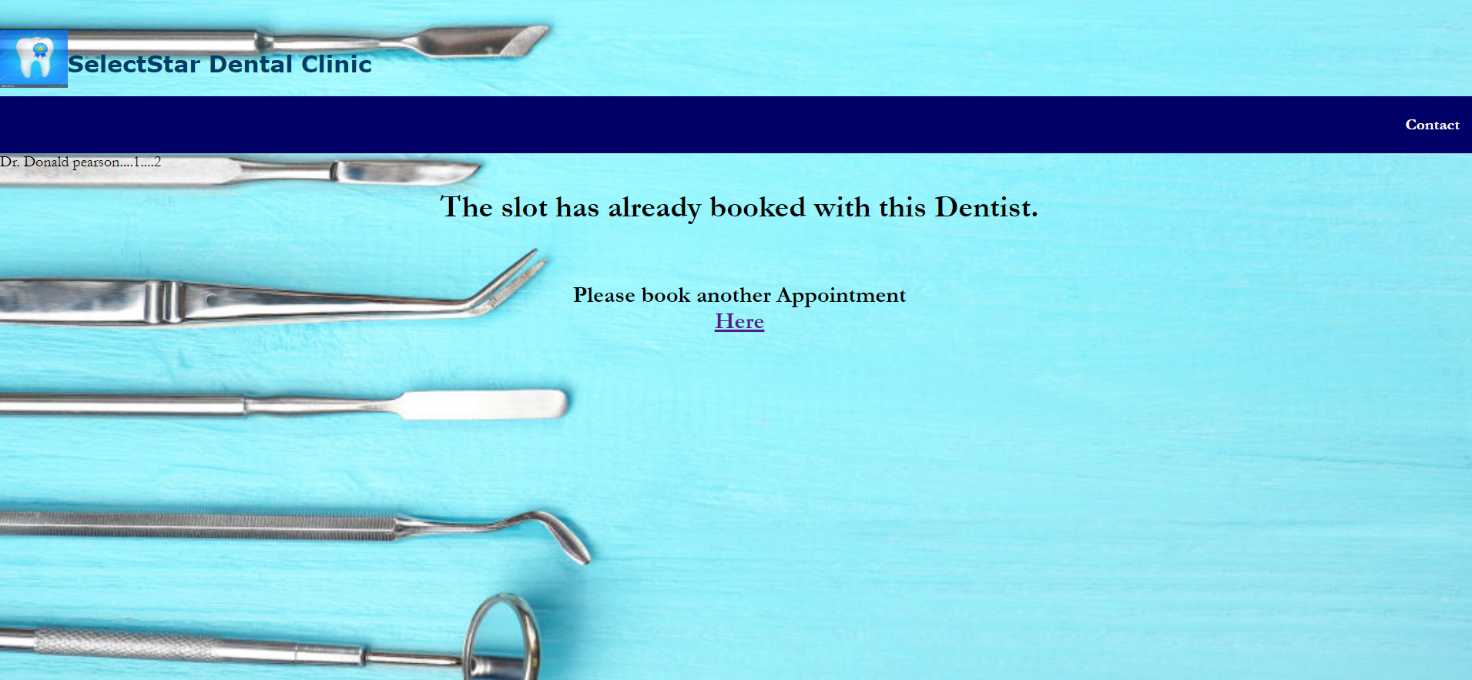
Conflicts on booking appointment

Slide 14
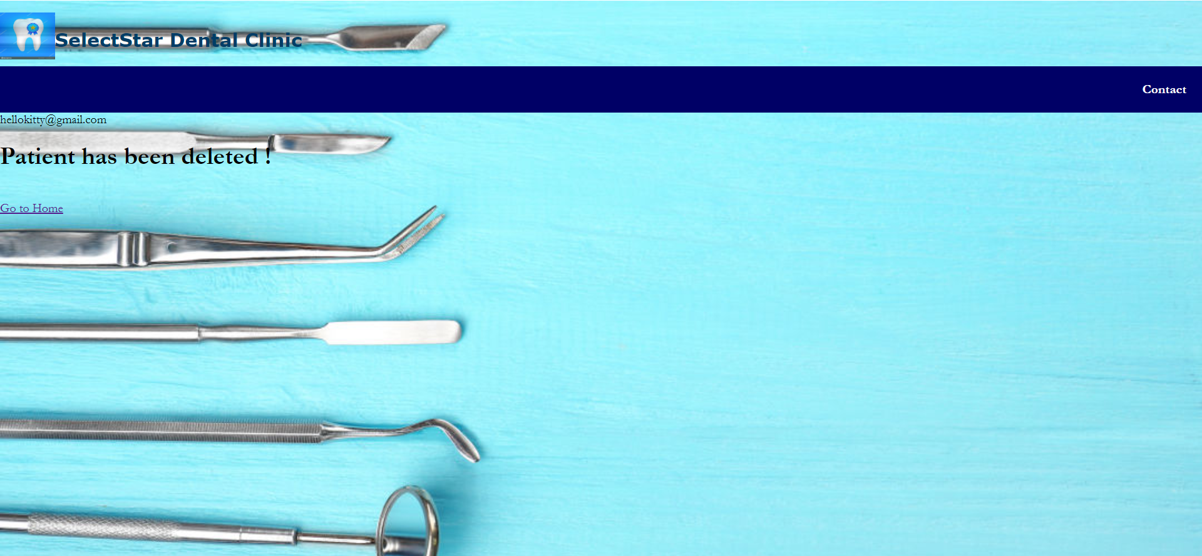
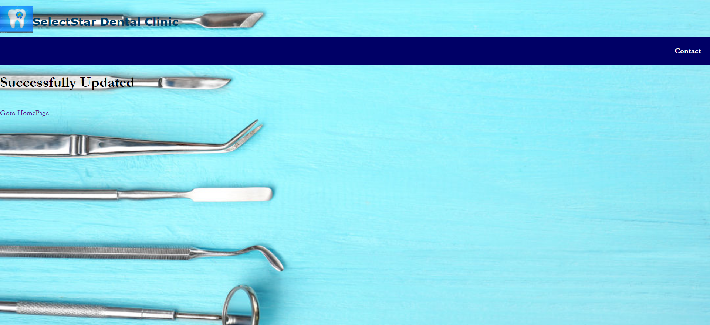
Update and Delete Patient

Slide 15
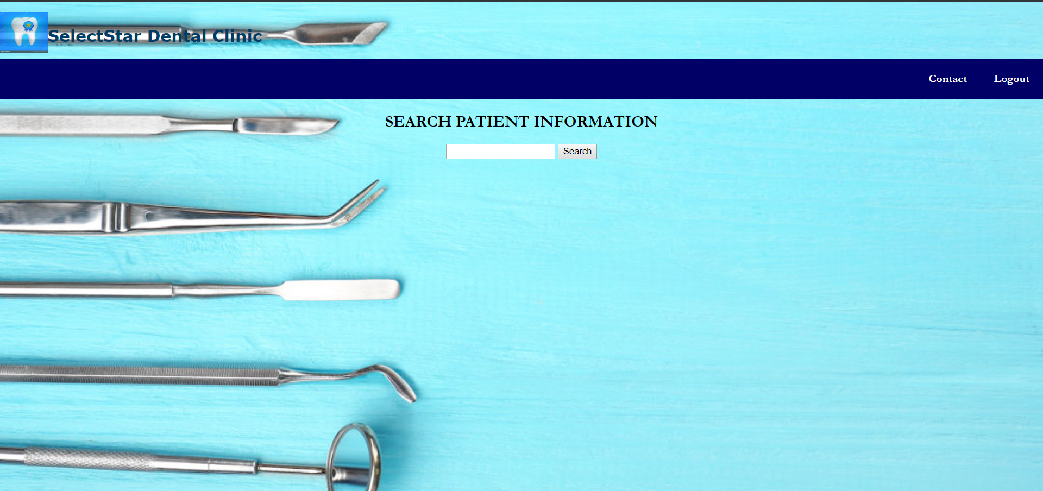
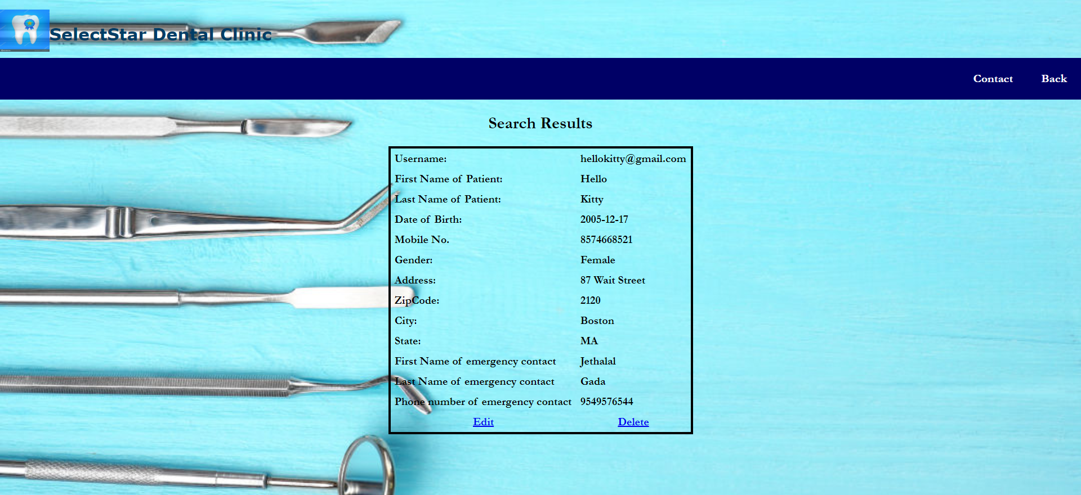
Search Patient

Slide 16
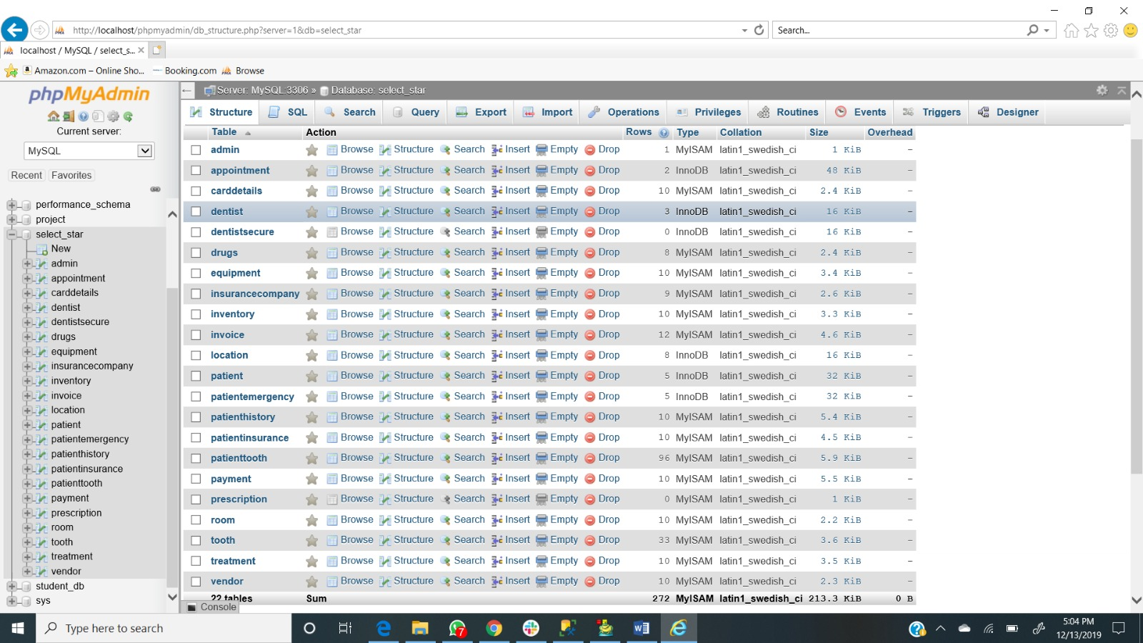
Database

Slide 17
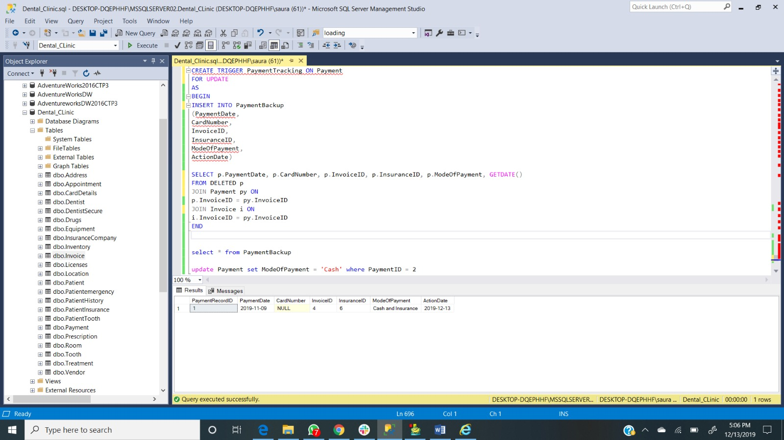
Trigger

Slide 18
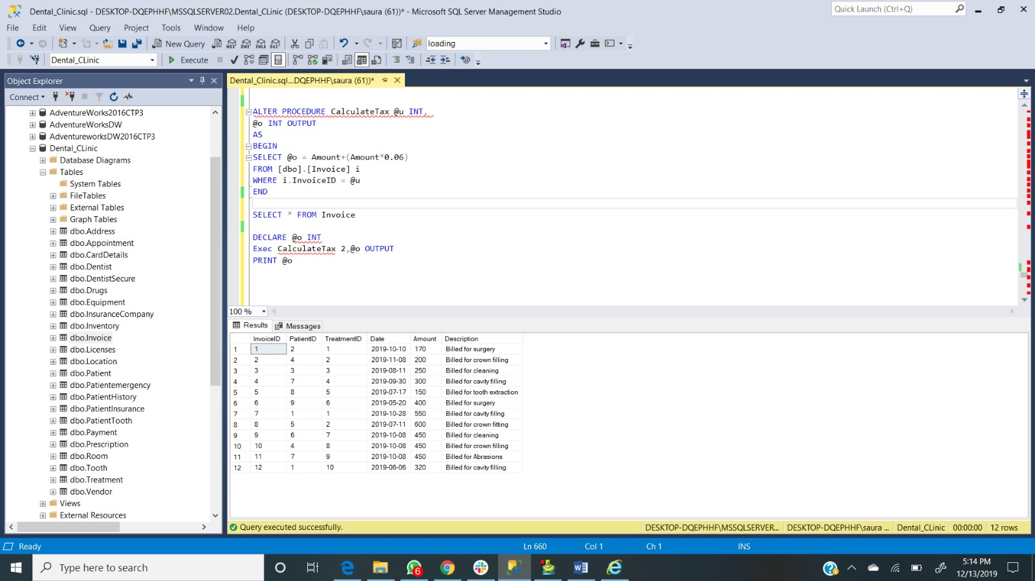
Procedure(1)

Slide 19
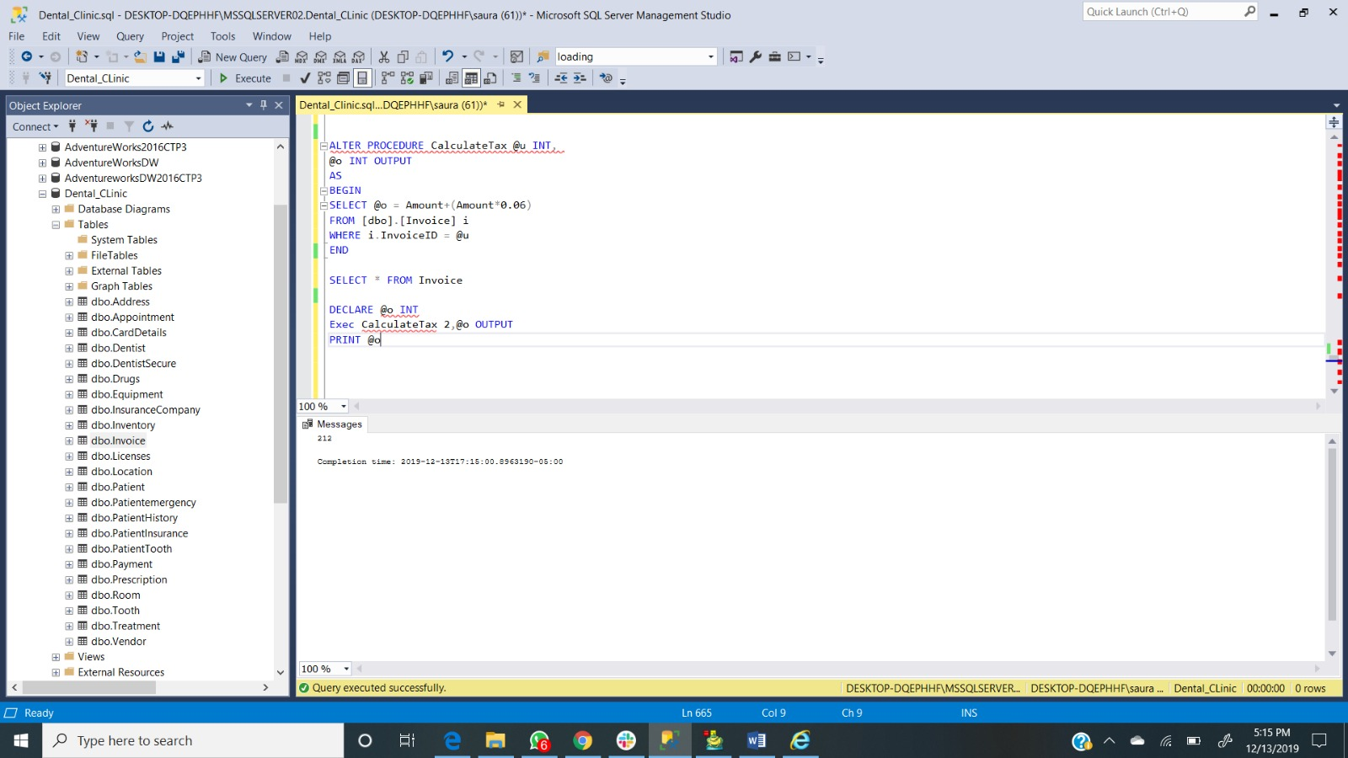
Procedure(2)

Slide 20
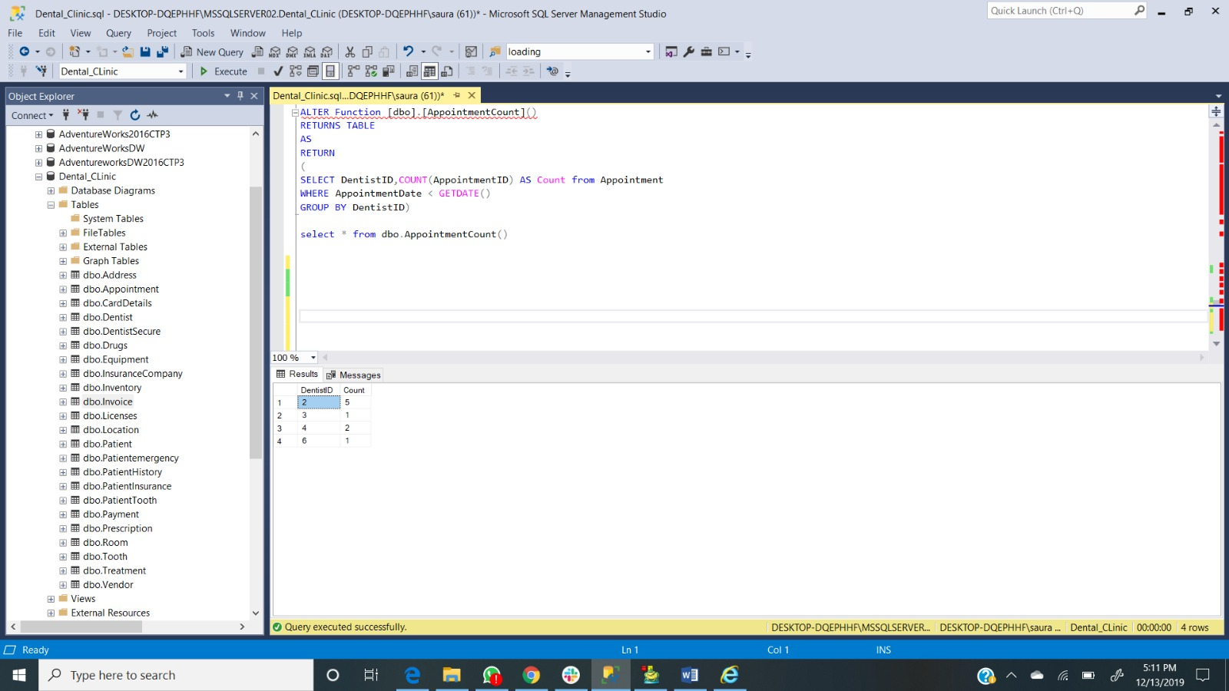
Function

Slide 21
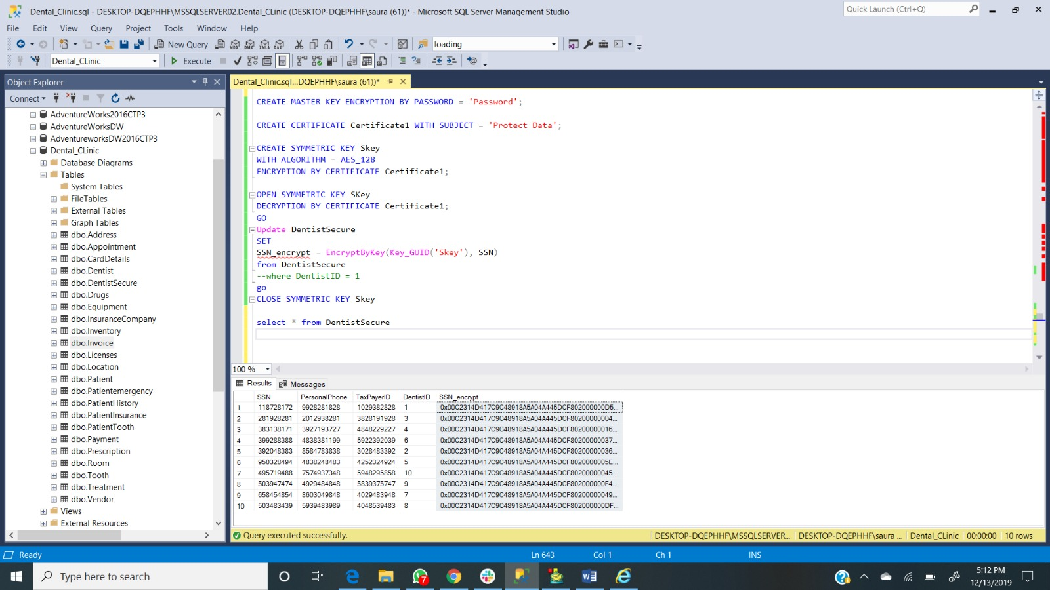
Encryption

Slide 22
Thank You

